Slide 1
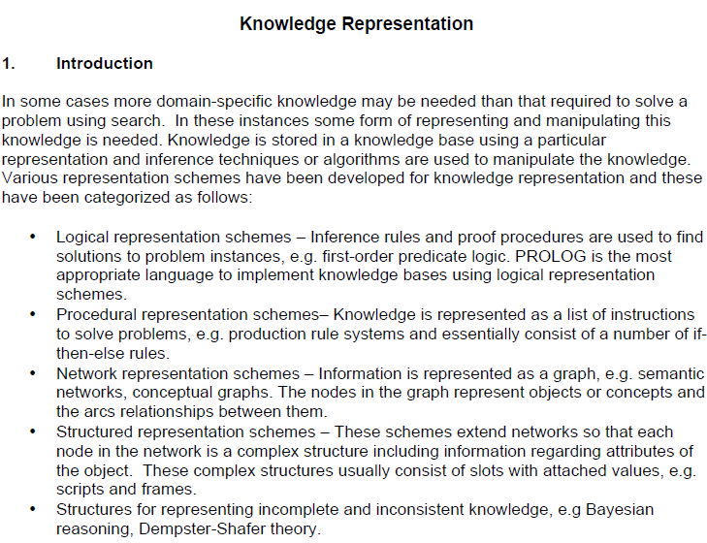

Slide 2
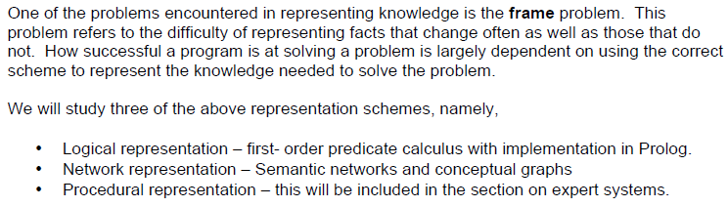
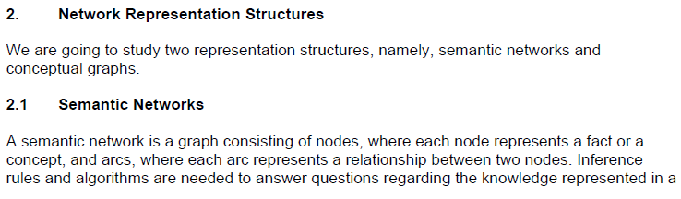

Slide 3
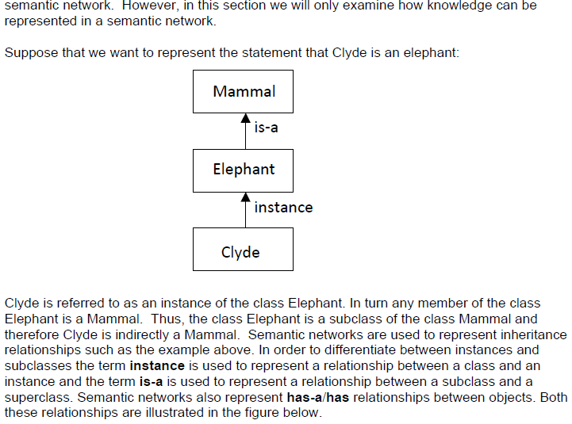

Slide 4
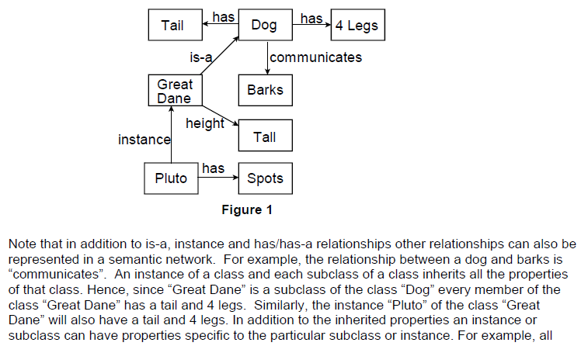

Slide 5
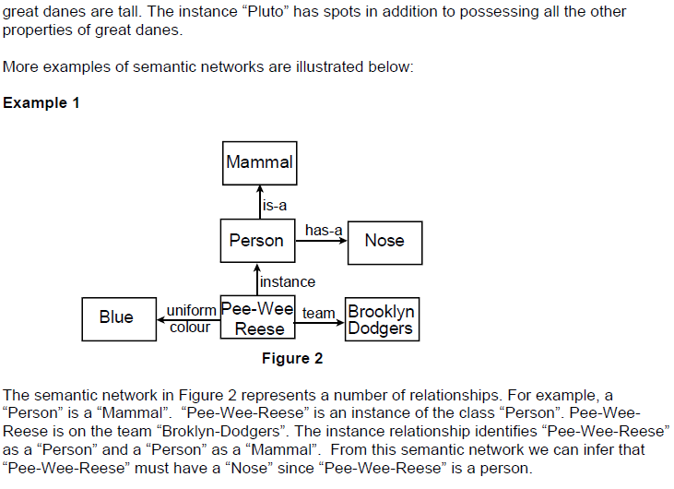

Slide 6
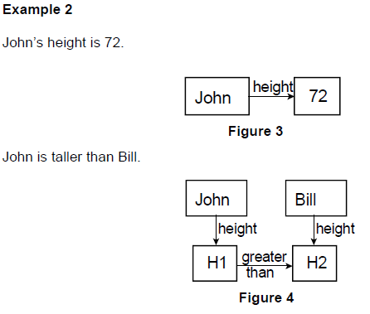

Slide 7
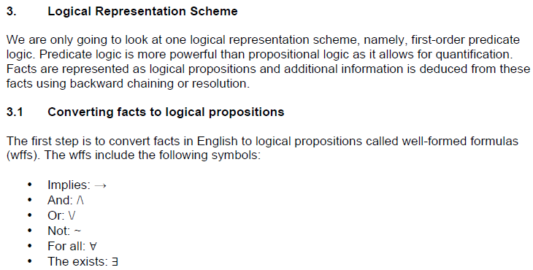

Slide 8
Some Examples of FOL using quantifier:
1. All birds fly. In this question the predicate is "fly(bird)." And since there are all birds who fly so it will be represented as follows. ∀x bird(x) →fly(x).
2. Every man respects his parent. In this question, the predicate is "respect(x, y)," where x=man, and y= parent. Since there is every man so will use ∀, and it will be represented as follows: ∀x man(x) → respects (x, parent).
3. Some boys play cricket. In this question, the predicate is "play(x, y)," where x= boys, and y= game. Since there are some boys so we will use ∃, and it will be represented as: ∃x boys(x) → play(x, cricket).

Slide 9
4. Not all students like both Mathematics and Science. In this question, the predicate is "like(x, y)," where x= student, and y= subject. Since there are not all students, so we will use ∀ with negation, so following representation for this: ¬∀ (x) [ student(x) → like(x, Mathematics) ∧ like(x, Science)].
5. Only one student failed in Mathematics. In this question, the predicate is "failed(x, y)," where x= student, and y= subject. Since there is only one student who failed in Mathematics, so we will use following representation for this: ∃(x) [ student(x) → failed (x, Mathematics) ∧∀ (y) [¬(x==y) ∧ student(y) → ¬failed (x, Mathematics)].

Slide 10
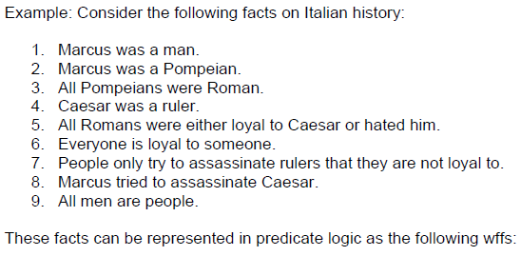
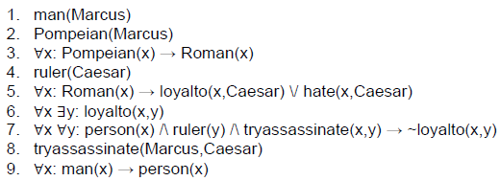

Slide 11
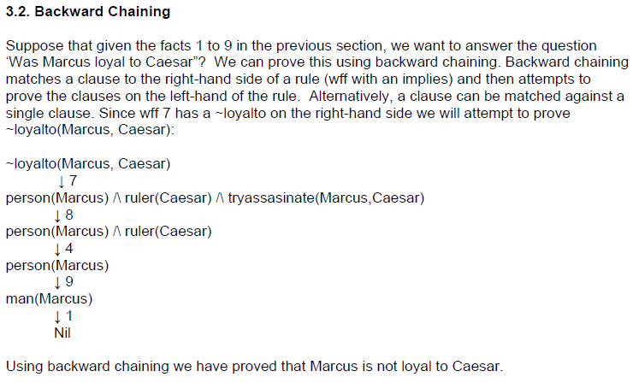

Slide 12
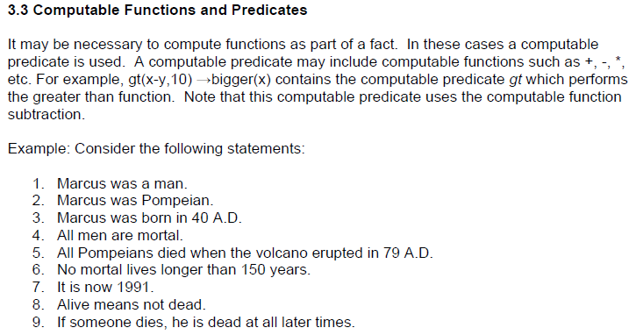

Slide 13
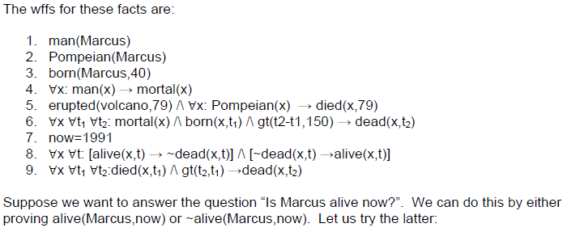

Slide 14
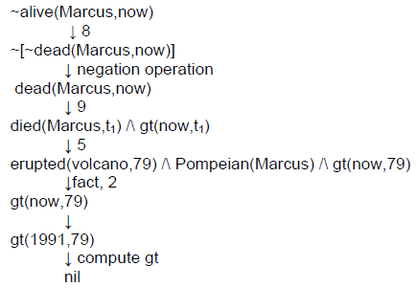

Slide 15
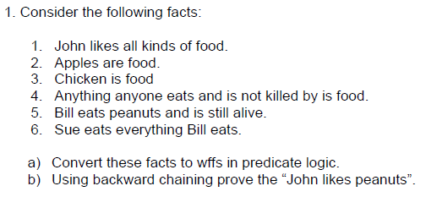
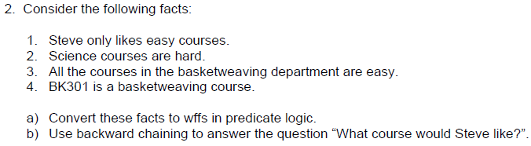

Slide 16
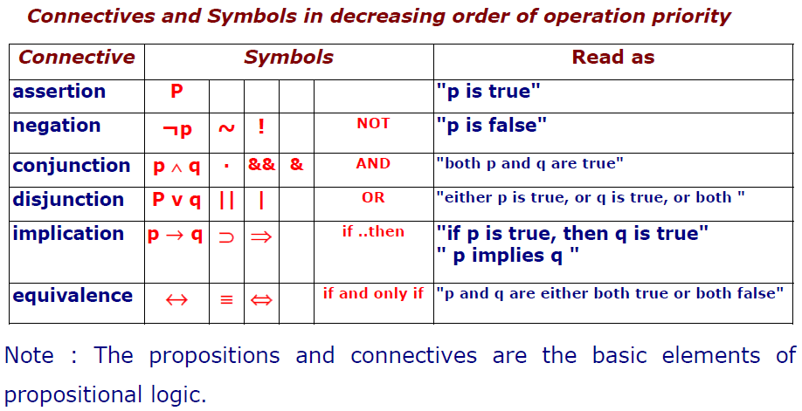
Conversion of Propositions into Formula and Truth Table

Slide 17
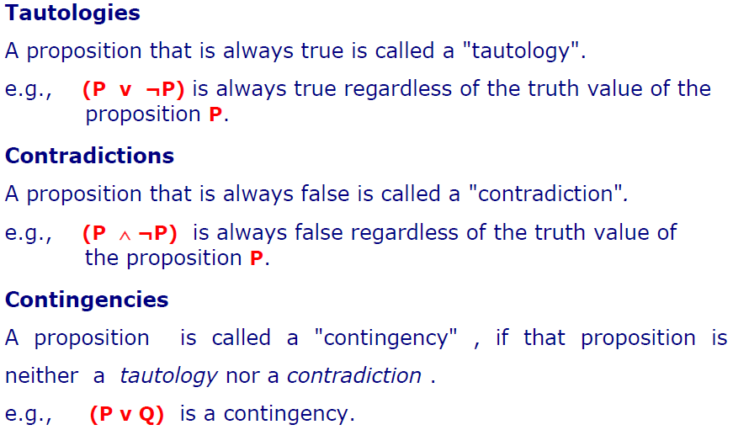

Slide 18
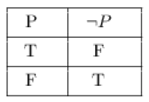
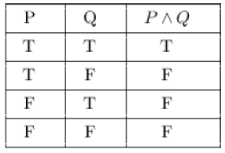

Slide 19
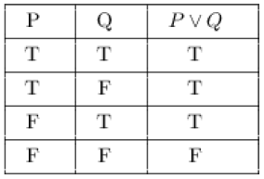
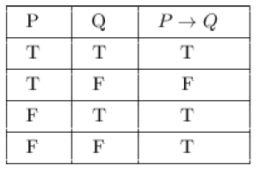

Slide 20
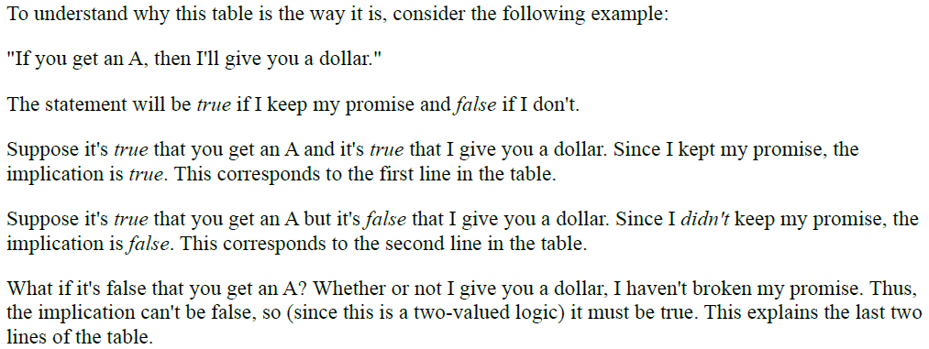

Slide 21
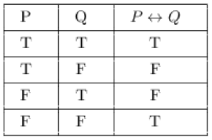
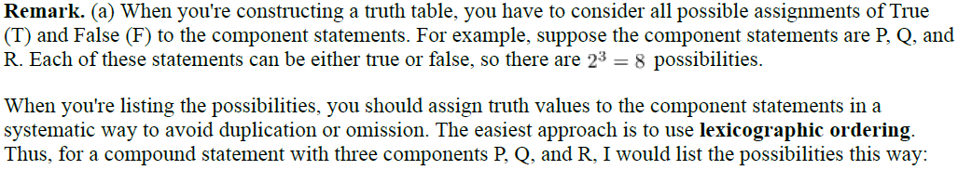

Slide 22
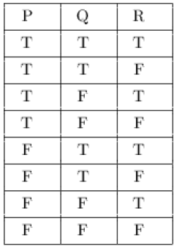

Slide 23
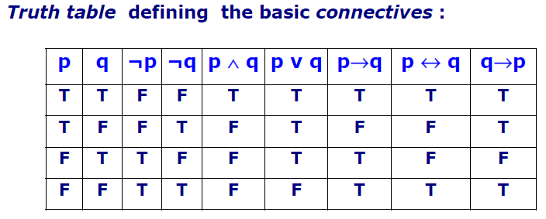

Slide 24
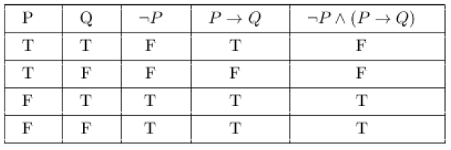

Slide 25
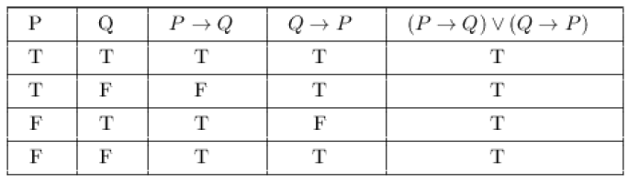

Slide 26
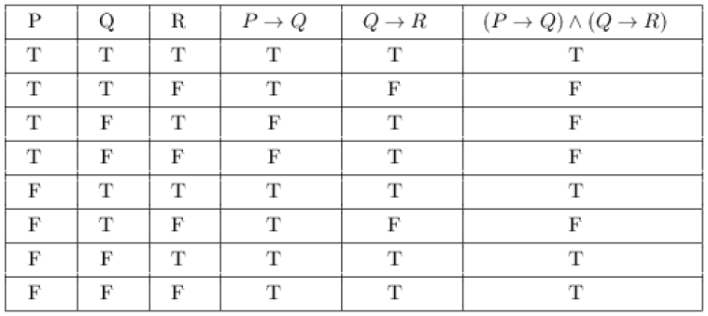

Slide 27
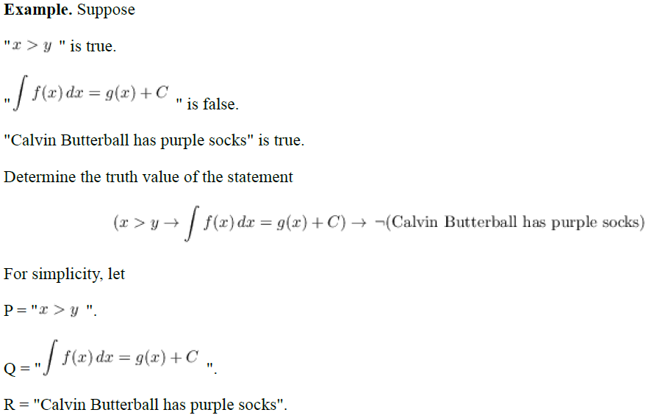


Slide 28
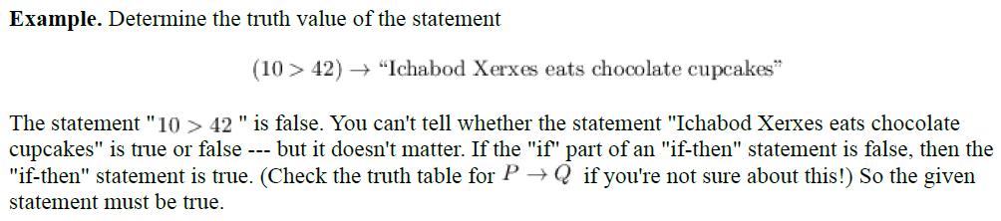
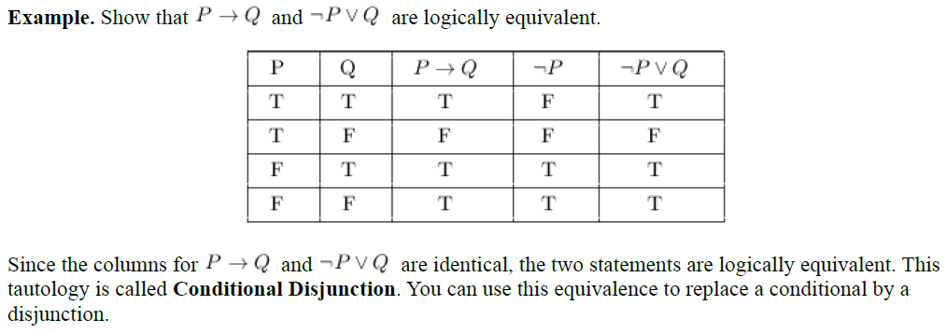

Slide 29
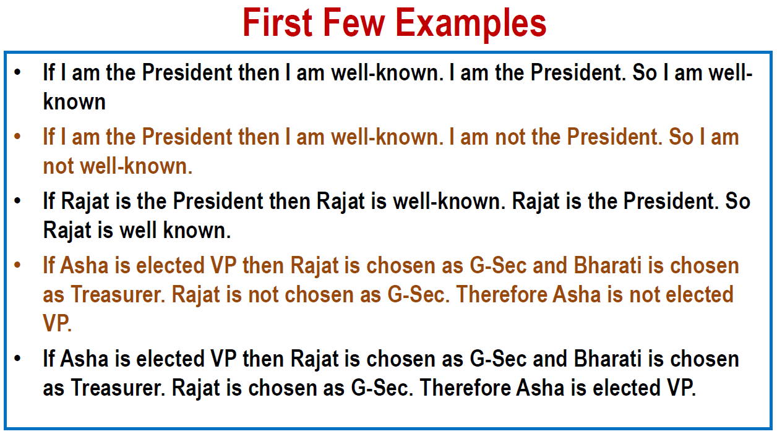

Slide 30
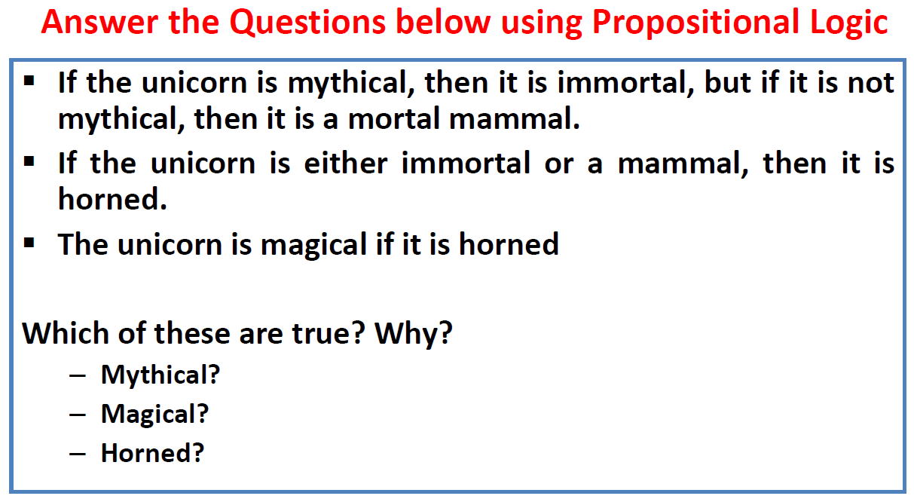

Slide 31
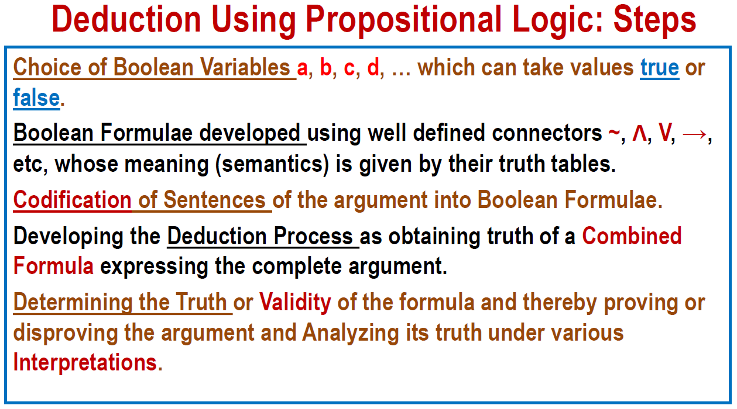

Slide 32
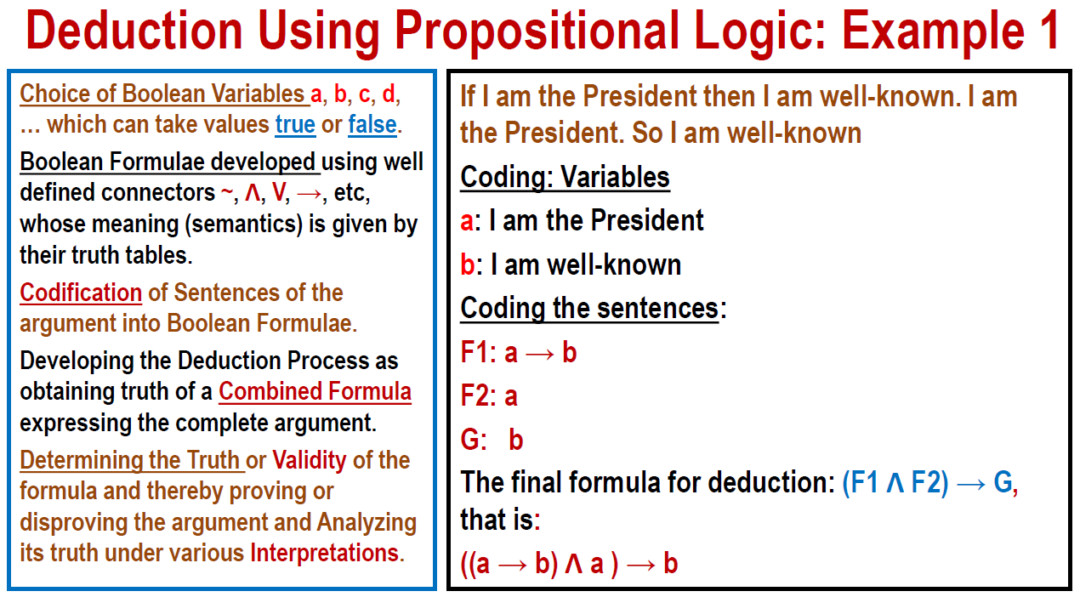

Slide 33
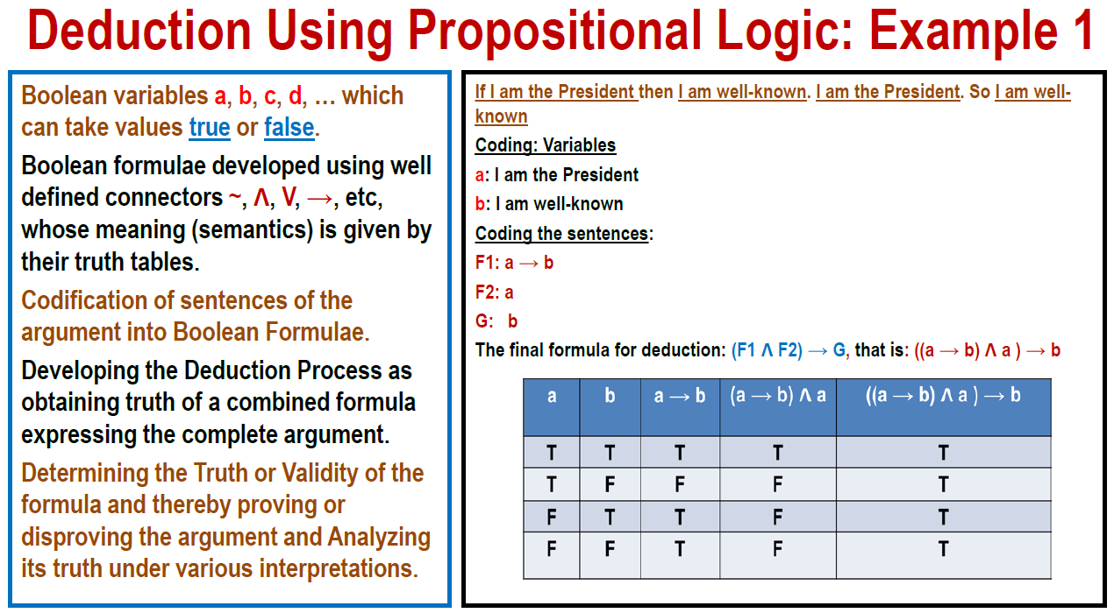

Slide 34
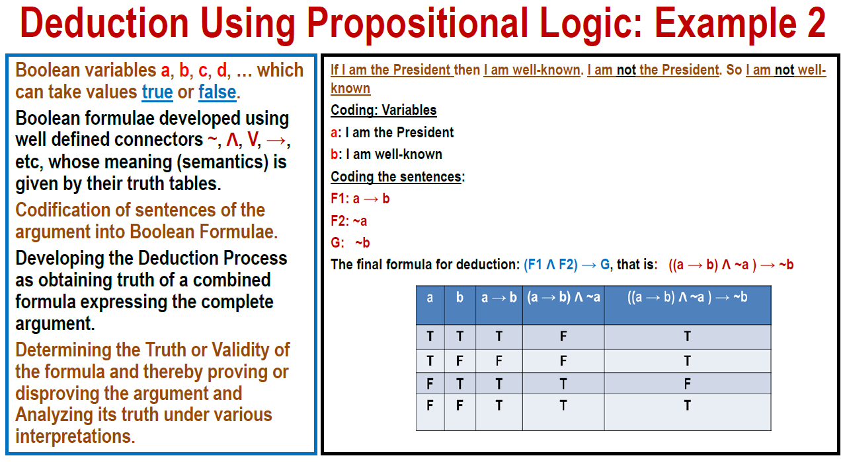

Slide 35
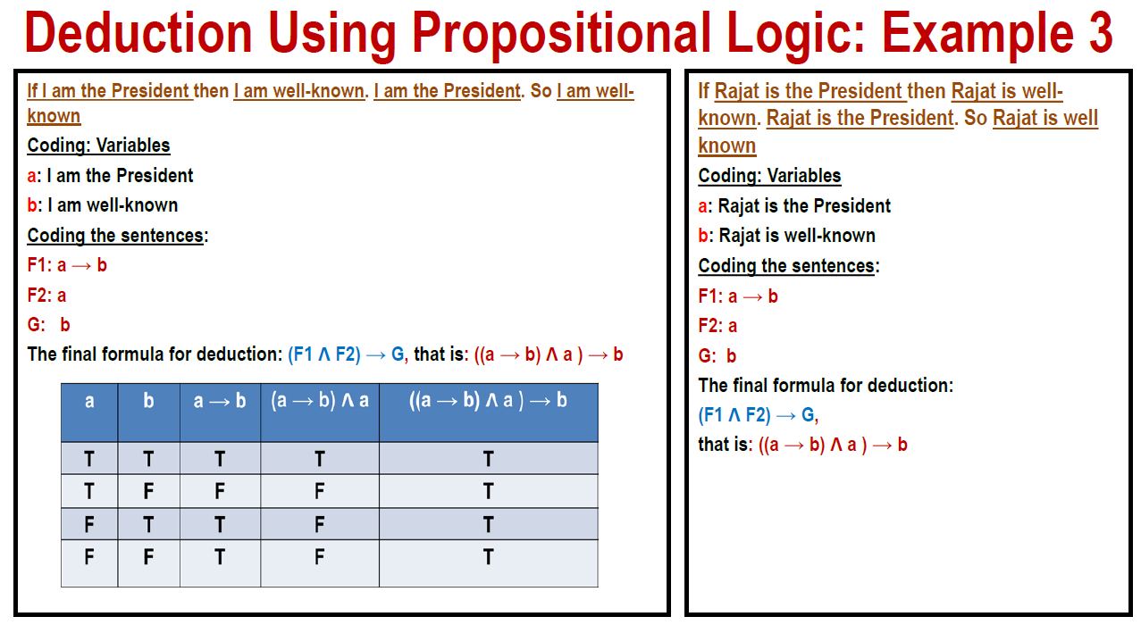

Slide 36
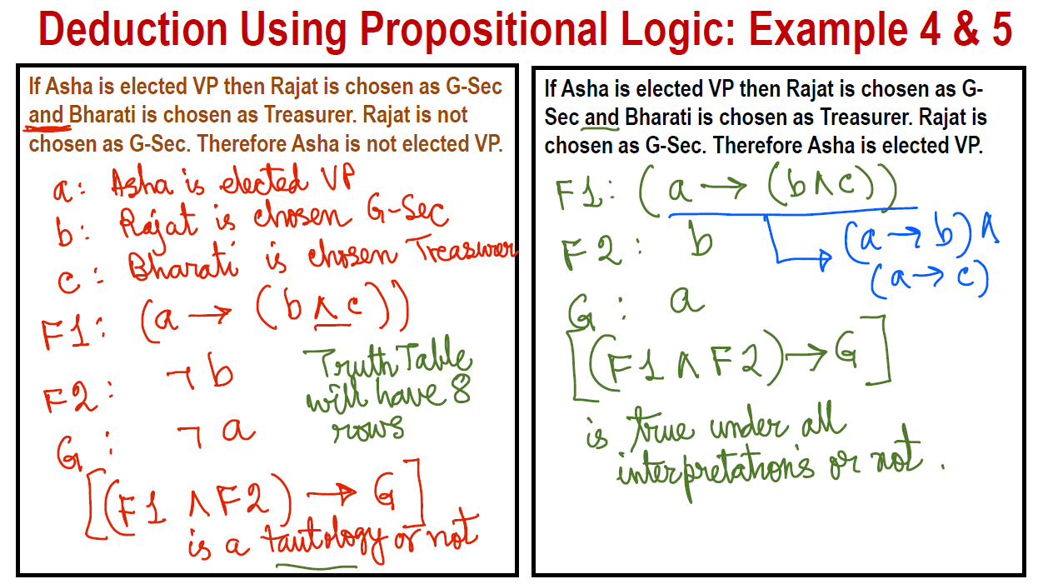

Slide 37
